Slide 1

Improving treatment outcome by adding different structural elements to outpatient substance abuse treatment programs offered to Danish youth.
Mads Uffe Pedersen & Sheila Jones
Centre for Alcohol and Drug Research
Aarhus University
Denmark
Notes:
My name is MUP and I am a professor in addiction research and psychology at CADR, Aarhus University, Denmark.
My colleque SJ, sitting there, is an assistant professor at the same center.
We are going to talk about the Youth Drug Abuse Treatment project and more precisely about the outcome of treatment can be improved by adding different structural elements to the treatment program. I will come back to what these structural elements are.

Slide 2
overview
The Youth Drug Abuse Treatment (YouthDAT) project
The treatment model
4 Treatment groups
Results
  Attendance and completed as planned
  Reduction and achieving abstinence
Notes:
In this presentation I will present the model and the 4 treatment groups that we compared and show you the outcomes of the different groups with regards to level of treatment attendance and completion as well as the level of change in drug use.

Slide 3
The YouthDAT project
http://www.isrctn.com/ISRCTN27473213
ISRCTN registry, BioMed Central
Notes:
You can find more details on the study in BioMeds RCT register through this link

Slide 4
Sample
460 youth from nine Danish municipalities
15 to 25 years of age
22,2 % women – 77,2 % men
93,5 % cannabis use last month before enrollment
30,0 % use of other drugs (amphetamine, cocaine etc.)
34 % has been diagnosed with a psychiatric disorder
Excluding youth with opioid abuse, severe psychotic disorders or aggressive/violent conduct
Notes:
In Denmark substance use treatment is carried out in municipal treatment centers and we have a 14 day treatment garantie, which means that persons seeking treatment must be offered some kind of treatment within 14 days of requesting treatment.
A total of 460 youth took part in this randomized case-controlled study that was carried out at 9 municipal treatment centers in Denmark.
Some of the characteristics of the youth are described here and we found that
.
.
.
34 % has been diagnosed with a psychiatric disorder. Most often depressions, anxiety, ADHD and perinality disorder, but also schizophrenia and autism.
There are very few opioid users in this age group in Denmark

Slide 5
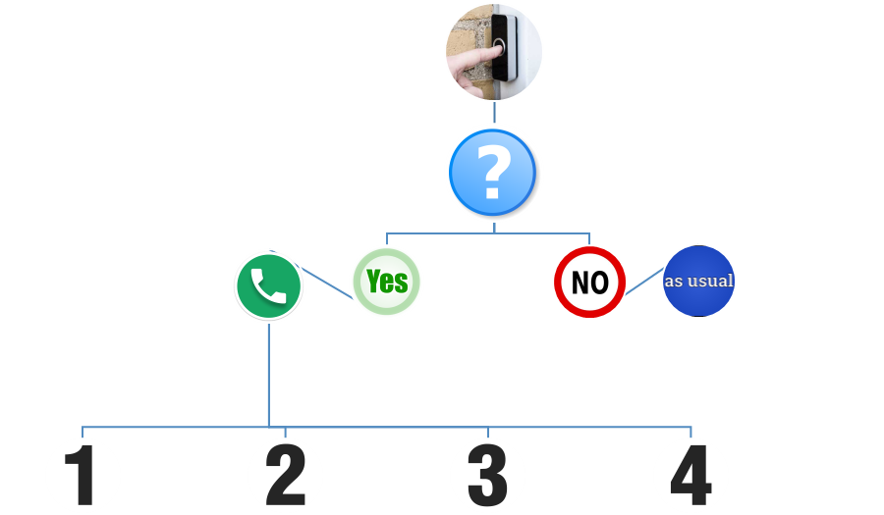

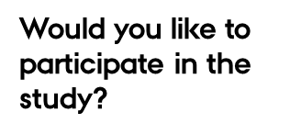
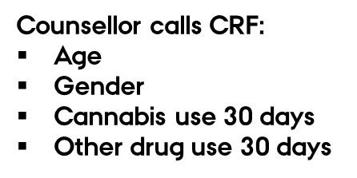
Randomization procedure
Youth is offered treatment as usual
Notes:
The project can be defined as a practice-experiment or an effectiveness study in contrast to an efficacy study.
The 460 youth were randomly allocated into one of 4 groups.
When the young person contacted the treatment center, they were asked if they would like to participate in the project. If they declined they were offered treatment as usual, if they consented they asked four questions and the administrative worker then called CADR and immediately after the young person were allocated in one of 4 groups.
This same procedure was carried out in all 9 municipalities.
The counsellors were also randomly allocated to the 4 treatment groups.

Slide 6
differences between groups
 | Group 1 | Group 2 | Group 3 | Group 4
 | n=114 | n=113 | n=112 | n=121 | p value
Age, mean | 20.4 | 20.6 | 20.3 | 20.6 | 0.78
Women (%) | 20.2 | 25.7 | 20.5 | 24.8 | 0.67
Cannabis use last month (days) | 22.1 | 20.9 | 20.2 | 20.8 | 0.59
Other drug use last month (yes/no) | 26.3 | 28.3 | 34.8 | 30.6 | 0.54
General drug severity (a) | 14,5 | 13,9 | 13,6 | 14,5 | 0.79
Psychiatric diagnosis (%) | 18.4 | 17.7 | 17.9 | 23.1 | 0.68
Illegal activies last month (yes/no) | 25.4 | 23.0 | 18.8 | 19.8 | 0.60
Friends using drugs (yes/no) | 82.2 | 85.0 | 83.5 | 87.7 | 0.72
Notes:
We did not find significant between group differences in variables usually linked to outcome.

Slide 7
Three dimensions of the treatment model

Slide 8
The three dimensions of the treatment model
Basic assumption
  The influence of barrieres and ressources, based on dialoque and respect, mutual aggreement on goals, positive reinforcement, structure.
Counselling techniques
  Motivational Interviewing,
  Cognitive Behavioral Therapy
Structural elements
  Next slide
Notes:
We divide treatment methods into 3 strongly interrelated dimensions: Basic assumptions, counselling techniques and structural element.
Basic assumptions includes values, philosophy etc. This could be fx. a moralistic approach or a disease approach with regards to how we understand addiction.
In this project, the primary goal is to achieve abstinence or reduction in drug use. In order to reach this goal it is of importance to establish a genuine alliance based on trust and agreement between counsellor and client with regards to working towards mutually accepted goals.
It is also necessary to identify and reduce mental, social or physical problems that act as barriers in achieving the overall goal – abstinence or reduction. Another assumption is that it is necessary to apply and reinforce the resources of the young people in achieving the goals.
The treatment is highly structured but also based on dialogue and mutual agreement on goals. The primary goal of reducing or ending the substance use is not the only goal that can be worked on during treatment, also goals of reducing or eliminating physical, social and/or social barrierers can be set as initial goals.
We could call it an interconnectedness approach.
The counselling technique is MI and CBT. All the counsellors has been educated, trained and surpervised in these method during the last two years.
And then we have the structural element.

Slide 9
Structural elements
Activity: Individual counselling sessions
Location: Municipal Substance abuse treatment center
Context: Interview room (primarely)
Intensity: 12 Weekly sessions. After care :14 telephone sessions and 4 personal sessions.
Time: Limited. Duration of each session: 45-60 min. After care : 3+3 month gradually phasing out.
Who: Young people 15-25 years of age. Involvement of social network and other professionals as needed.
Media: face-to-face, telephone/mobil, text message reminders, videobased supervision
Materials: assessment tools, treatment plans/contracts, gift cards (vouchers), status letters, manuals, logbook, notes.
Notes:
The various structural elements are described here.
The four groups differed with regards to which elements were used in the treatment.
Those that are written in black were common elements for all 4 groups while those in blue constitutes the differences between the 4 groups.

Slide 10
The four treatment groups

Slide 11
The four treatment groups
Structural elements
 | MIKAT | MIKAT-G | MIKAT-O | MIKAT-GO
12 sessions (primary) | + | + | + | +
Assessment (YouthMap) | + | + | + | +
MI (MI) | + | + | + | +
CBT (KAT) | + | + | + | +
Vouchers/gift card (G) |  | + |  | +
Aftercare (O) |  |  | + | +
Reminders |  |  | + | +
Contract and status letters |  |  | + | +
MI = Motivational Interviewing
CBT = Cognitive Behavioral Therapy
Notes:
The differences between the 4 group can be seen here.
All youth received CBT and MI, all were given 12 weekly sessions, and all were screened using YouthMap, which is a short screening measure identifying barriers or ressources that may be important to take into account in the treatment planning.
One group received these elements only,
In addition one group delivered vouchers of 25 euro to the youth every other time they attended a session.
One group send reminders prior to each session, created a contract with the youth on the goals of treatment as well as 6 months follow-up treatment that gradually faded out
And one group gave both vouchers and follow-up treatment
All counsellors received training prior to the project and were given supervision throughout.

Slide 12
Results
  Attendance and completed as planned
  Reduction and achieving abstinence

Slide 13
Counselling sessions (12 offered)
Completed as planned
 |  |  | Number of |  | Completed
 |  |  | counselling | t-test | as planned | t-test
 |  |  | sessions | p value | percent | p value
MIKAT |  |  | 5.1 | ref. | 25.4 | ref.
MIKAT-G | Voucher |  | 7.1 | 0.0003 | 46.0 | 0.001
MIKAT-O |  | Reminders | 6.8 | 0.004 | 39.3 | 0.03
MIKAT-GO | Voucher | Reminders | 7.7 | <0.0001 | 48.8 | 0.0002
Notes:
Reminders and vouchers, and not least the combination of both, surely improve retention.
Not very surprising.

Slide 14
Three follow-ups completed
 | 3 month follow-up | 6 month follow-up | 9 month follow-up
Participation | 76,1 % | 67,0 % | 64,3 %
Notes:
The patients were contacted 3,6 and 9 month after the assessment interview and the youth were given a voucher of about 14 euro each time they participated in the follow-up.
The response percent was 76,1, 67,0 and 64,4 %.

Slide 15
Abstinence in % (raw)
Drug use intake
N=460
Drug use
3 month
N=350
Drug use
6 month
N=308
Drug use
9 month
N=296
Notes:
Between 1-3 % of the youth had not used drugs the month prior to treatment.

Slide 16
Abstinence in % (LOCF)
Drug use intake
N=460
Drug use
3 month
N=460
Drug use
6 month
N=460
Drug use
9 month
N=460
Notes:
Missing data was filled out with the last observation

Slide 17
Abstinence (different models)
 | Model 1 |  |  | Model 2
 | Raw |  |  | LOCF
 | Percent | OR | p value | Percent | OR | p. value
MIKAT-GO | 50,0 | ref. 1.00 |  | 38.8 | ref. 1.00
MIKAT | 36.6 | 0.56 | 0.083 | 24.6 | *0.50 | 0.019
MIKAT-G | 30.6 | *0.43 | 0.013 | 25.7 | *0.53 | 0.029
MIKAT-O | 31.9 | *0.45 | 0.019 | 25,0 | *0.51 | 0.020
Model 1: 460 (1), 350 (2), 308 (3), 296 (4)
Model 2: 460 all four interviews
Controlled for drug use at intake, gender and age.
* p<0.05
Notes:
A logistic regression was carried out controlled for drug use at intake, gender and age
We also carried out a mixed effect analyse

Slide 18
Conclusion
Treatment is not only about using evidence-based conselling methods/techniques.
Structural elements can improve retention significantly
The combination of and dynamic between different structural elements can be signicantly linked to reduction of drug use/achiving abstinence
Structural elements are more easy to implement i different treatment settings..

Slide 19

Thank you for your attention!

